Slide 1

A Framework for Exploring Game Metadata
Jericho McLeod

Slide 2
Research Purpose
How do we study behavior in a large sample space?
Model the sample space
evaluate the model
Utilize the model
How do we determine model components?
Explore the sample space
Given a specific sample space can I create a useful tool for exploratory analysis?
Notes:
I thought it would be interesting to build a tool to further explore data and find the anomalies that are observed. This project is a stepping stone in that direction.
It allows some utility in exploring the sample space, but doesn’t specifically help identify anomalies yet, as it does not plot things over time or contain the necessary dimensionality.

Slide 3
Project ProCESS
Data gathering
Data Cleaning
Data exploration
Learn the basics of JavaScript and D3.js
Create force directed graph – not functional for analysis
Create radial graph
Implement interactive features
Notes:
Data gathering: as previously discussed, I gathered data from MTGJSON.com, deckstats.net, and MTGTop8.com
Data Cleaning: I primarily cleaned data with python
Data Exploration: I used frontend software from my company, Microstrategy, to explore network graphs of the data I gathered
Learning basics: web research, coursera, and lots of stack overflow
Force directed graph: D3 and again stack overflow
Radial graph: used D3 for data reading and element creation, javascript functions for math, and JSON for data fiiles
Interactive features: mouseover and onclick events were used from D3

Slide 4
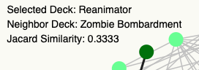
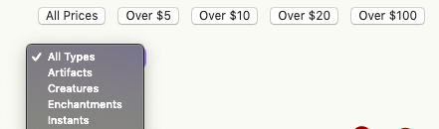
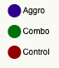
Process Scorecard
Data Gathering
Python API wrapper for tcgplayer
Manual data gathering from mtgtop8
Data Exploration using force directed graphs
Jaccard’s Similarity
Filtering by price and card type
Color by deck type
Notes:
Data gathering was complete as of the last demo.
Data exploration had also been completed, though at the time I was rendering separate web pages for filtering. This is now conducted on a single page.

Slide 5
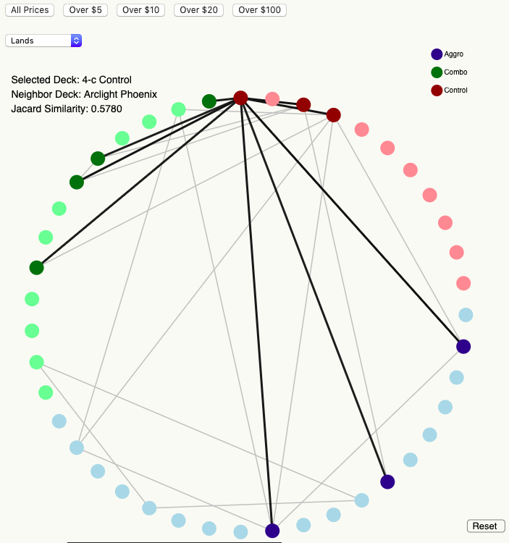
Process Scorecard
Use radial graph with interactivity through single-page filtering
Implemented
Implement Transitions
Not Implemented
Highlight decks with click
Implemented
Tooltip showing transition costs to other decks
Partially implemented
Notes:
As you’ve seen, I got a radial graph to function.
Transitions are still be bit beyond me, as I’m not making full use of Javascript yet.
Specifically, I’m still using functions and loops to draw elements
Highlighting was completed, and tooltips are also included, but do not show transition costs in terms of dollars.
It isn’t a far reach to get to that point, just a bit more data manipulation, as I currently have the data I’d need to precalculate it for each deck.

Slide 6
Progress toward Future Steps
Deal with computational expense of cost filtering
Pre-calculated for visualization using Python
Implemented in current visualization
Include win/loss data
Data obtained
Include player quantities with deck data
Solved at data gathering phase
Compile over time to study meta topology
Solved at data source
Notes:
On the note of precalculation, I did implement that to overcome one of my prior obstacles: it also greatly improves render time.
I obtained better win/loss data, but think the best move is to utilize it alongside a cost function rather than just deck similarity, over time.
This lets you see how costs and win rates relate, and identify contrasting moves, which is something I’m interested in studying further.
I also currently have the number of players piloting each deck, which may also be useful in that research.
Finally, I have the tools to gather data in an ongoing basis now, so I can start compiling data to make this graph evolve over time as a new dimension.

Slide 7
Page Design
Nodes in a Radial Layout
Calculate (x,y) Coordinates
X = circle width * radius * Cos(2𝜋 * (index of node / length of node list) )
Y = circle width * radius * Sin(2𝜋 * (index of node / length of node list) )
Edges in graph:
Line from Node A (x,y) coordinates to Node B (x,y) coordinates
Draw first so that nodes draw on top of edges
Notes:
Since I didn’t use any existing functions to create the layout, it took a tiny bit of trig to get the layout right. I didn’t have any particular need to start at a specific position, but you could update this to move the start point.
The edges were pretty trivial to layout after I had node positions calculated, but I was initially drawing them last because that was the mental order I had; that rendered them on top of nodes once I stopped printing everything in black and white.

Slide 8
Page Design
Highlighting Logic:
Loop through link list
If target node in link: copy to highlight list
If target node not in link: copy to non-highlight list
Draw non-highlight list with lighter colors
Draw highlight list with darker colors second to appear on top
Notes:
Highlight just creates two subsets and then draws one one lighter and one darker.
The darker group then has the mouseover function added for the static tooltip.

Slide 9
Page Design
Workarounds used frequently
I have a poor understanding DOM interface and retrieving current data structures in console
For (i=0; i<someData.length; i++) { }
Console.log(someData[i])
D3.selectAll(“someClass > *”).remove()
Notes:
Since I’m still rather iffy with javascript, some of the things I used to work around my limitations were
Using loops to add html elements
Lots of console printing to see what exactly I had just done to myself
And clearing everything between draws; this causes a flicker of a single frame in some cases

Slide 10
Lessons learned
There are no one-size-fits-all visualization solutions
Force Directed does not always work
Radial layout takes careful consideration in implementation
Arcs may be better than lines
Hierarchical may be better than pure circle layouts
Pre-processing datasets is very useful for network visualizations
Many of the delays in my visualizations are from processing data in browser
Start with the reasons for a visualization; feedback from uninformed users will be more meaningful
Notes:
I learned that force directed had more appeal to me as a novelty than actual utility for this dataset, which I probably should have just asked.
Radial layouts aren’t necessarily as simple as drawing lines. I think updating my visualization to arcs would definitely help clean it up some, but also
Just using a radial hierarchy, especially with the animated transitions we read about, should be the ultimate destination to explore this dataset.
Preprocessing data for drawing networks where possible is pretty great. I have some minor delays from data processing and redrawing, but the vast
Majority is pre processed.
I showed the work-in-progress to a fair number of people but without context. I got much better feedback once I gave context, so this became a bit of
An experiment in what context people need to understand a visualization. Going forward, I’ll start with the explanation before showing anyone a
Graph so that they can understand from the outset what is going on.

Slide 11
Future work
Implement animated radial graph with ‘back’ and ‘forward’ options across history of selections
Implement edges by dollar cost of walking
Compare win rates and costs over time
Notes:
To keep improving this and get to the point where I can use it to examine what interesting things may be happening in isolated areas of the sample space, I want to
Use an animated radial hierarchy with the ability to move back and forward through highlighted selections.
The edges between nodes should be valued in dollar costs rather than overall deck similarity
And I still need to involve win rates and costs over time

Slide 12
Thank you
Any questions?

